Slide 1


Programming in Java, 2e
Sachin Malhotra
Saurabh Choudhary

Slide 2
Chapter 12
Applets

Slide 3
Objectives
Understand the difference between applet and application
Understand the lifecycle of an applet
Learn how applets are created and executed
create Shapes within applets
Use Images in Applets
Use Threads in Applet and create a Digital clock

Slide 4
Introduction
Applet is small java programs, which can be easily transported over the network from one computer to other.
used in internet applications,
embedded in an html page, can be downloaded from the server and run on the client, so as to do a specific kind of job.

Slide 5
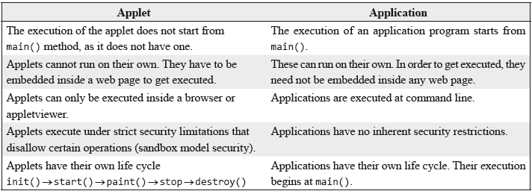
Difference between an applet and application

Slide 6
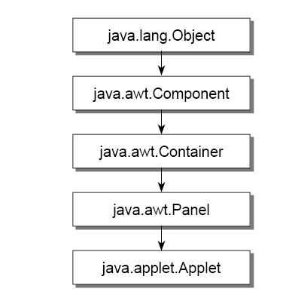
APPLET CLASS
java.applet.Applet is the super class of the all the applets.
Applet class has a predefined hierarchy

Slide 7
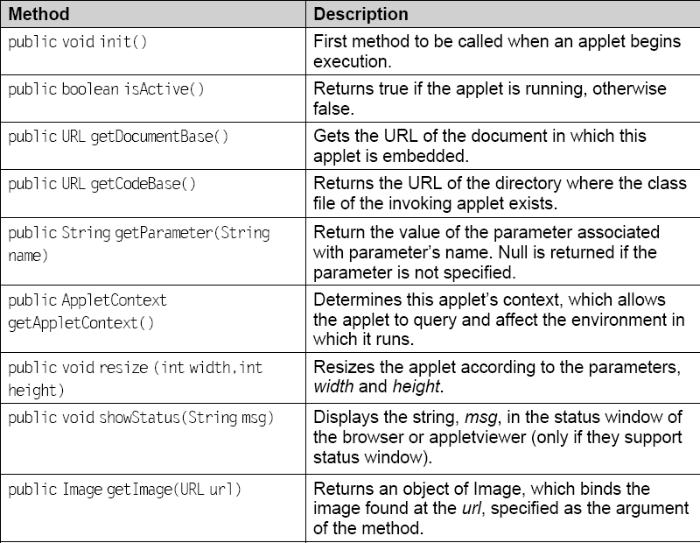
Few methods of Applet class

Slide 8
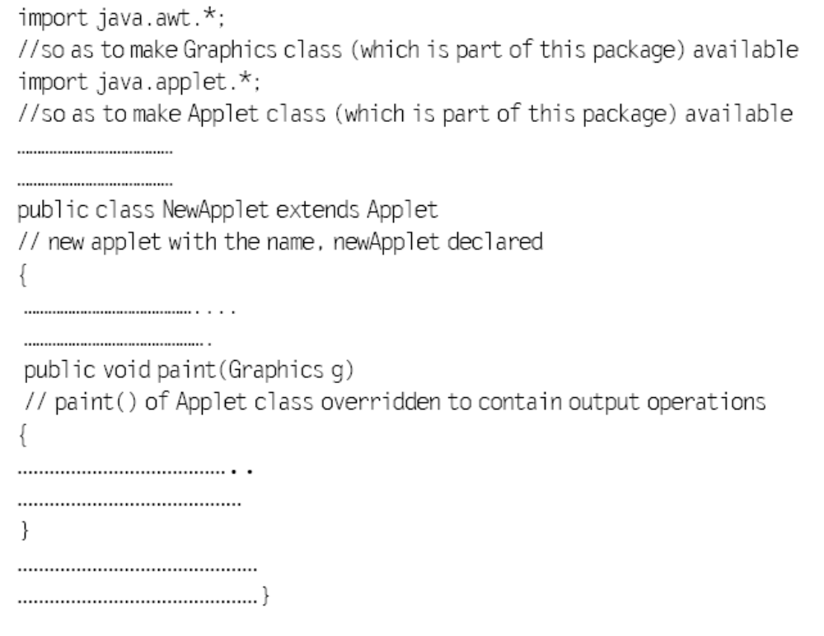
Applet Structure

Slide 9
Applet Example
import java.applet.*;
import java.awt.*;
public class FirstApplet extends Applet {
public void paint(Graphics g) {
g.drawString(“This is my first applet program”, 10,20);
}
}

Slide 10
Running an Applet
There are two ways to run the applet.
  1. Add the applet tag within the body of the html tag
    <HTML><BODY>
    <APPLET code = "FirstApplet.class" WIDTH = 200 HEIGHT = 150></APPLET>
    </BODY></HTML>
  You can execute the HTML file by giving appletviewer FirstApplet.html

Slide 11
Running an Applet (contd.)
2. Add the Applet tag as a comment in the java source file
In order to run the applet You have to give the below HTML coding as a comment in the source file :
/* <APPLET code = "FirstApplet.class" WIDTH = 200 HEIGHT = 150></APPLET> */
Execute the applet as: appletviewer FirstApplet.java

Slide 12
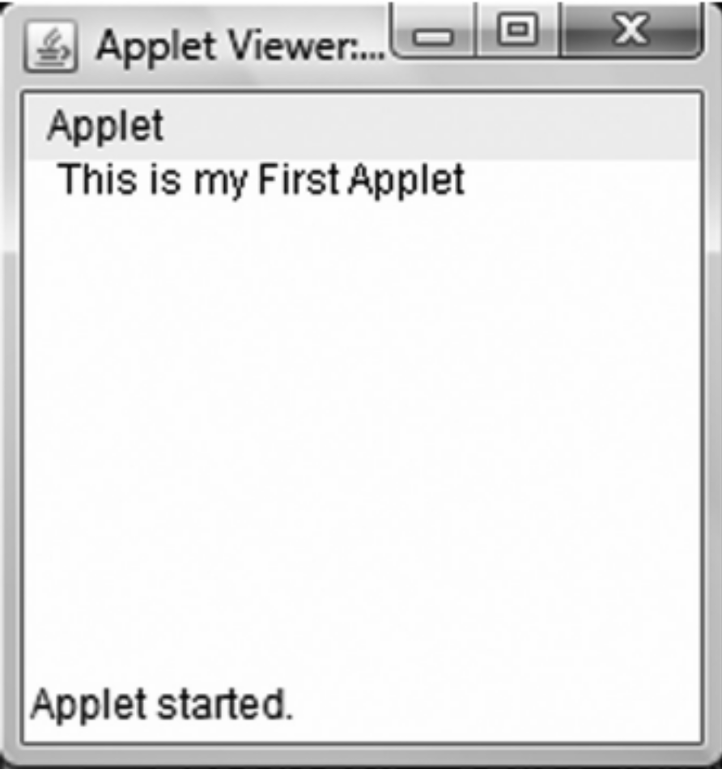
The Output

Slide 13
Applet Life cycle
An applet may move from one state to another depending upon a set of default behaviour inherited in the form of methods from ‘Applet’ class.
These states are
  Born
  Running
  Idle
  Dead

Slide 14
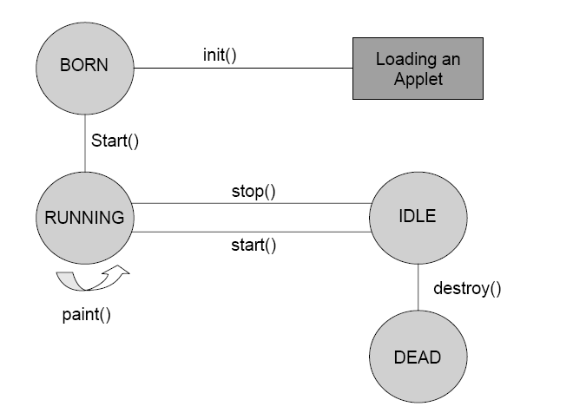
Applet State Diagram

Slide 15
Life cycle of Applet
init() –
  creates the objects needed by the applet;
  sets up initial values, load font and images or set up colors.
  called only once during the lifetime of on Applet.
start()
  moves to this phase automatically after the initialization state.
  if the applet is stopped or it goes to idle state, start() method must be called in order to force the applet again to the running state.
paint()
  This method is called each time to draw and redraw the output of an applet.
stop()
  idle state, once it is stopped from running
destroy()
  An applet goes to dead state when it is destroyed by invoking the destroy() method of Applet class.
  It results in complete removal of applet from the memory.

Slide 16
Common Methods
drawString():
  member of Graphics class, used to output a string to an applet.
  It is typically called from within the paint() or update() method.
  void drawString(String msg,int a, int b)
setBackground() & getBackground()
  belongs to Component class, used to set and get the background color.
  void setBackground(Color anyColor)
  predefined constants for each color, such as Color.red can be used.
setForeground() & get Foreground()
  set and gets the color of the text to be displayed on the foreground of the applet window.
  void setForeground(Color anyColor)
showStatus()
  display any string in the status window of the browser
  void showStatus(String text)

Slide 17
Example
/* <APPLET code = “ExampleApplet.class” WIDTH = 200 HEIGHT = 150></APPLET> */
import java.applet.Applet;
import java.awt.Color;
import java.awt.Graphics;
public class ExampleApplet extends Applet{
String text;
public void init() {
setBackground(Color.white);
setForeground(Color.red);
text = “This is an example applet”;
System.out.println(“....Initialized the applet”);}
public void start() {
System.out.println(“....Starting of the applet”);}

Slide 18
Example (contd.)
public void stop() {
System.out.println(“....Stopping the applet”);}
public void destroy() {
System.out.println(“....Exiting the applet”);
}
public void paint(Graphics g) {
System.out.println(“....Painting the applet”);
g.drawString(text, 30, 30);
showStatus(“This is status bar”);
}}

Slide 19
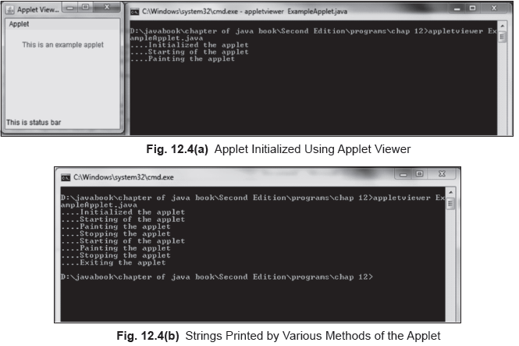

The Output

Slide 20
Paint, update & repaint
All components and containers in the JDK have two methods that are called by the system to paint their surface.
  public void paint(Graphics g);
  public void update(Graphics g);
If you wish that a drawing should appear in a window, you shall override either or both of the methods.
paint()
  for drawing/redrawing paint() method is called.
  The component draws itself when it first becomes visible.
  The component paint() method is also invoked when the window containing it is uncovered, if it is covered by another window.

Slide 21
Example
/* <APPLET code = “FillOval.class” WIDTH = 200 HEIGHT = 200></APPLET> */
import java.applet.Applet;
import java.awt.Color;
import java.awt.Graphics;
public class FillOval extends Applet{
public void paint(Graphics g) {
g.setColor(Color.red);
g.fillOval(20, 20, 60, 60);
}
}

Slide 22
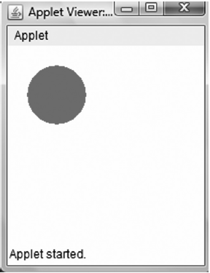
The Output

Slide 23
update() method
It clears the surface of the calling component to its background color and then calls the paint() method to paint the rest of the component.
It makes the job easier because one does not have to draw the whole component within a paint() method, as the background is already filled. Then, when one overrides paint(), he/she only needs to draw what should appear on the foreground.

Slide 24
repaint() method
if you have changed certain properties of a component to reflect its new appearance, you can call the repaint() method.
  text.setBackground(Color.blue);
  text.repaint();
Calling the repaint() method causes the whole component to be repainted.
repaint() in its default implementation calls update() which in turn calls paint().
repaint() method requests the AWT to call update and it returns. The AWT combines multiple rapid repaint requests into one request (usually this happens when you repaint inside a loop). So the last repaint in the sequence actually causes paint().

Slide 25
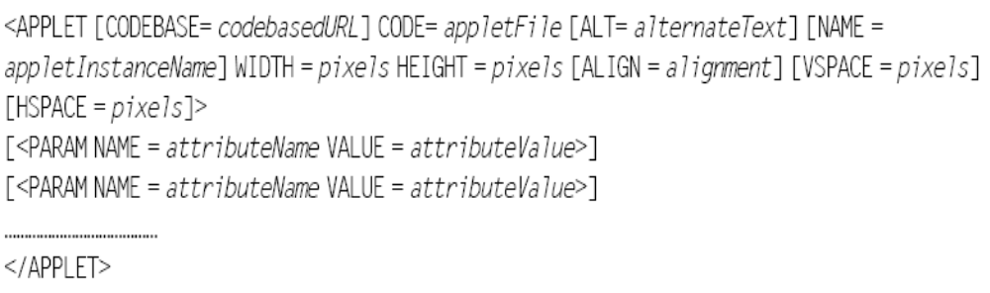
Applet Tag

Slide 26
Applet Tag
CODEBASE - specifies the URL of the directory where the executable class file of the applet will be searched for.
CODE - It gives the name of the file containing the applet’s compiled class file.
ALT - specifies the alternate short text message that should be displayed in case the browser recognizes the HTML tag but cannot actually run the applet because of some reason.
NAME - give a name to an applet’s instance
WIDTH - gives the width of the applet display area in terms of pixels.
HEIGHT - gives the height of the applet display area in terms of pixels.
ALIGN - set the alignment of an applet. The alignment can be set as LEFT, RIGHT, TOP, BOTTOM, MIDDLE, BASELINE, TEXTTOP, ABSMIDDLE, and ABSBOTTOM.
VSPACE - used to specify the space, in pixels, above and below the applet.

Slide 27
Applet tag (contd.)
HSPACE
  These are used to specify the space, in pixels, on each side of the applet.
PARAM sub tag
  provides information about parameters, or arguments, to be used by the Java applet.
  The <PARAM> tag is simple—it NAMES a parameter and provides a VALUE for that parameter.
  This tag has two attributes
    NAME: attribute name
    VALUE: value of the attribute named by corresponding PARAM NAME.
  The applets access their attributes using the getParameter() method.
  String getParameter(String name);

Slide 28
Param tag Example
/*<APPLET CODE = ParamPassing.class WIDTH = 300 HEIGHT = 250>
<param NAME = yourName VALUE = John>
<param NAME = yourProfession VALUE = consultant>
<param NAME = yourAge VALUE = 35> </applet>*/
import java.awt.*;
import java.applet.*;
public class ParamPassing extends Applet {
String name; String profession; int age;
public void start() {
String str;
name = getParameter(“yourName”);
if (name == null) name = “not found”;
str = getParameter(“yourProfession”);
if (str != null) profession = str;

Slide 29
Param Tag Example (contd.)
else profession = “No job”;
str = getParameter(“yourAge”);
try {
if (str != null)
age = Integer.parseInt(str);
else age = 0;
} catch (NumberFormatException e) {}
}
public void paint(Graphics g) {
g.drawString(“your name: “+name, 10, 10);
g.drawString(“your profession: “+profession, 10, 30);
g.drawString(“your age: “ +age, 10, 50);
}}

Slide 30
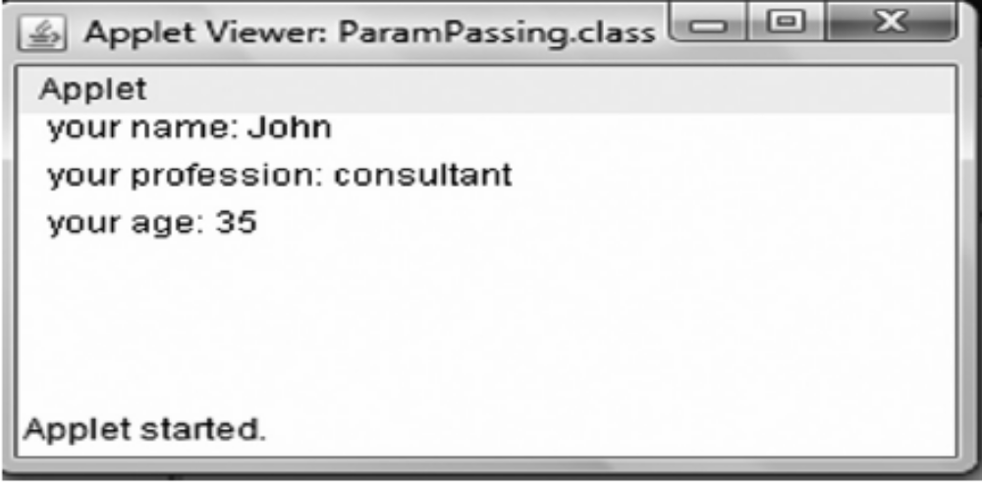
The Output

Slide 31
getDocumentBase() and getCodeBase()
getDocumentBase() returns the URL of the directory that holds the HTML file responsible for starting the applet in the form of URL object
getCodeBase() returns the URL object of the directory from where the class file of the applet is loaded.

Slide 32
AppletContext Interface
This interface corresponds to an applet’s environment: the document containing the applet and other applets in the same document.
In other words, this interface determines this applet’s context, which allows the applet to query and affect the environment in which it runs.
This environment of an applet represents the document that contains the applet.
The methods in this interface can be used by an applet to obtain information about its environment.

Slide 33
Communication Between Applets
showDocument() enables your applet to transfer control to any other URL.
  public abstract void showDocument(URL url);
  The url specifies where you want your applet to transfer control to
You can use this method only with the object of the currently executing applet, which can be obtained by getAppletContext()
After that, your browser or appletviewer can show another document or web page by using showDocument(url).
  try {
  getAppletContext( ).showDocument(new URL(url));
  } catch (java.net.MalformedURLException e) {
  System.out.println(“URL could not be reached”);}
showDocument() method, has one more form
  public abstract void showDocument(URL url, String target)
  This argument indicates in which HTML frame the document is to be displayed. The target arguments can be used in following forms.

Slide 34
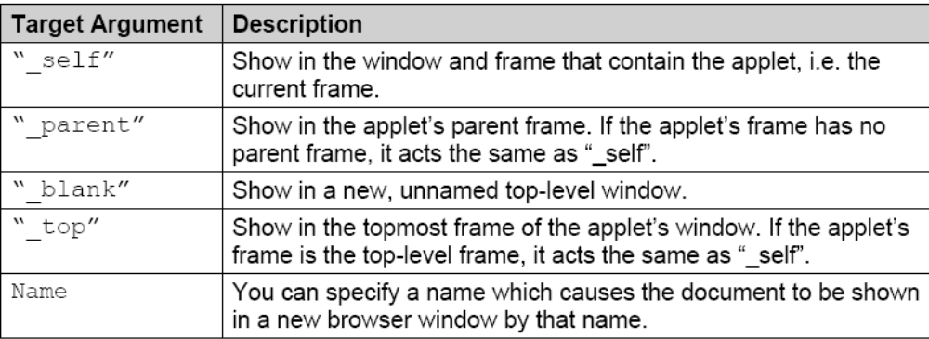
Target attribute of showDocument()

Slide 35
Audio Clip
You can load a clip using the method getAudioclip() of the Applet class, which returns an AudioClip object. The signature of this method is,
  AudioClip getAudioClip(URL url)
This object actually encapsulates the audio clip found at the specified url, passed as the argument to the method
These methods can be used by the audio clip object (returned by getAudioClip()) to either play, stop, or loop an audio clip.
  play(): plays a clip from the beginning
  stop(): stops playing the clip
  loop(): plays the clip in loop continuously

Slide 36
IMAGES IN APPLET
public class ImageDemo extends Applet{
Image image;
public void init() {
image = getImage(getDocumentBase(),"bulbon.gif");}
public void paint(Graphics g) {
//drawImage(Image img,int x,int y,int width, int height, // ImageObserver observer)
g.drawImage(image, 0, 0, image.getWidth(this),image.getHeight(this), this);
g.drawImage(image, 0, 200, 70,90, this); }}

Slide 37
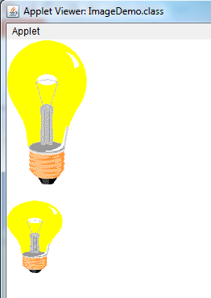
The Output

Slide 38
MediaTracker class
import java.applet.Applet;
import java.awt.*;
public class MediaTrackerDemo extends Applet implements Runnable{
// image array to hold images
Image[] imageArray = null;
// to track the images
MediaTracker m = null;
int current = 0;
Thread t=null;

Slide 39
MediaTracker class
public void init(){
m = new MediaTracker(this);
// Create an array of three images
imageArray = new Image[2];
// Start downloading the fi rst images into the image array
imageArray[0] = getImage(getDocumentBase(), "bulboff.gif");
// Register it with media tracker
m.addImage(imageArray[0], 0);
// second image
imageArray[1] = getImage(getDocumentBase(), "bulbon.gif");
m.addImage(imageArray[1], 1);

Slide 40
MediaTracker class
// Start thread to begin blinking of images
t = new Thread(this);
t.start();}
public void paint (Graphics g){
g.setColor(Color.white);
// Sets the background with White Color
g.fillRect(0,0, 400, 400);
// Sets the Color as black, so that any text written will be black
g.setColor(Color.black);
// Check to see if images have loaded
if (m.checkAll()){
g.drawImage(imageArray[current++], 0, 0, this);

Slide 41
MediaTracker class
if (current >= imageArray.length)
current = 0;}
else {// Still loading
g.drawString ("Images are still loading...", 20,20);}}
public void run(){
try{
// waits until all the images have fi nished loading
m.waitForAll();
for (;;){ // Repaint the images
repaint();
Thread.sleep(2000);}}
catch (InterruptedException ie){}}}

Slide 42
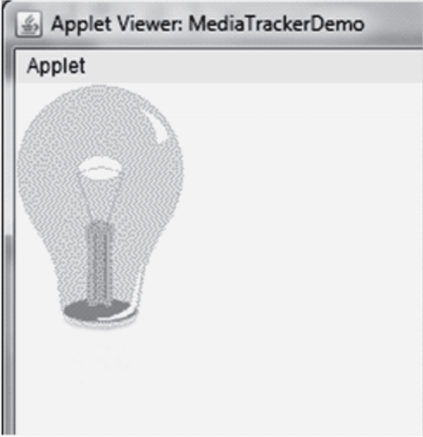
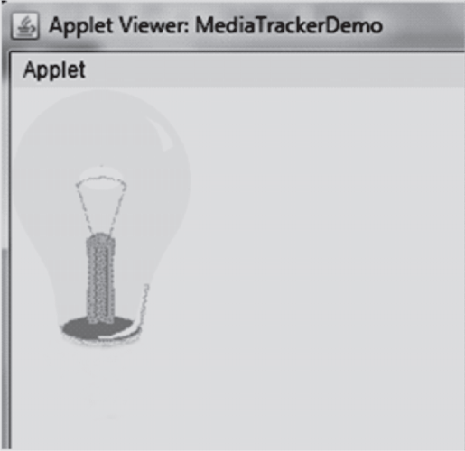
The Output

Slide 43
Graphics class
import java.awt.* ;
import java.applet.* ;
public class DrawLineRect extends Applet {
public void paint(Graphics g){
g.drawRect(10,60,40,30);
g.fillRect(60,10,30,80);
g.fillOval(140,160,170,170);
g.drawRoundRect(10,100,80,50,10,10);
g.fillRoundRect(20,110,60,30,5,5);
g.drawArc(280,210,250,220,30,90);
g.drawLine(100,10,230,140);
g.drawLine(100,140,230,10);
}}

Slide 44
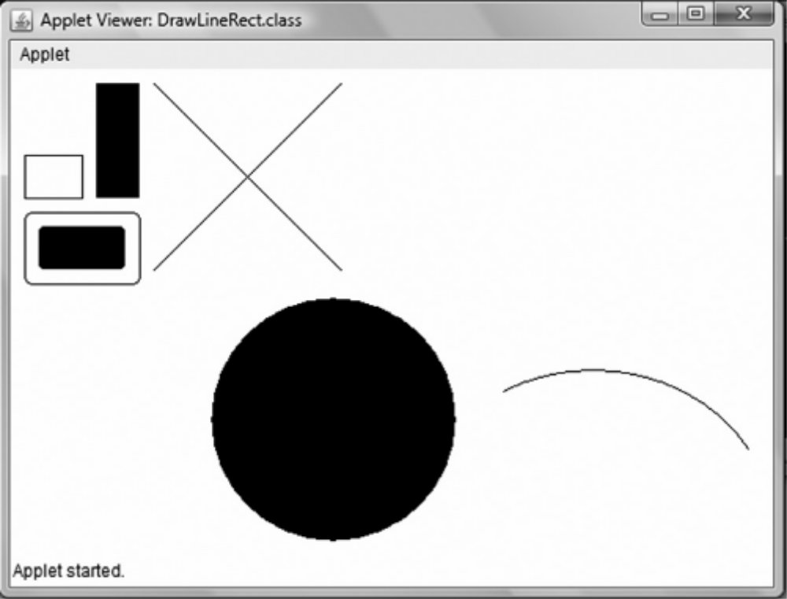
The Output

Slide 45
Font & Color class
/*<applet code=ColorFont.class width=600 height = 270 > < / applet >*/
import java.awt.*;
public class ColorFont extends java.applet.Applet{
public void init() {
Color color1 = new Color(230, 220, 0);
setBackground(color1);}
public void paint(Graphics g) {
String str = “”;
String FontList[];
GraphicsEnvironment ge = GraphicsEnvironment.getLocalGraphicsEnvironment();
FontList = ge.getAvailableFontFamilyNames();
for (int i =0; i<FontList.length; i++) {
g.drawString(“FONTS AVAILABLE ARE:”, 5, 30);
str += FontList[i] + “, “;

Slide 46
Example (contd.)
g.drawString(str,5, 50);}
Color color2 = new Color(235, 50, 50);
g.setColor(color2);
g.drawString(“Hey Look!!!”, 5, 180);
Font currentFont = new Font(“TimesRoman”, Font.PLAIN, 20);
g.setFont(currentFont);
g.drawString(“This is an example”, 5, 220);
currentFont = new Font(“TimesRoman”, Font.ITALIC, 40);
g.setFont(currentFont);
g.drawString(“You must have understood.....”, 5, 260);}}

Slide 47
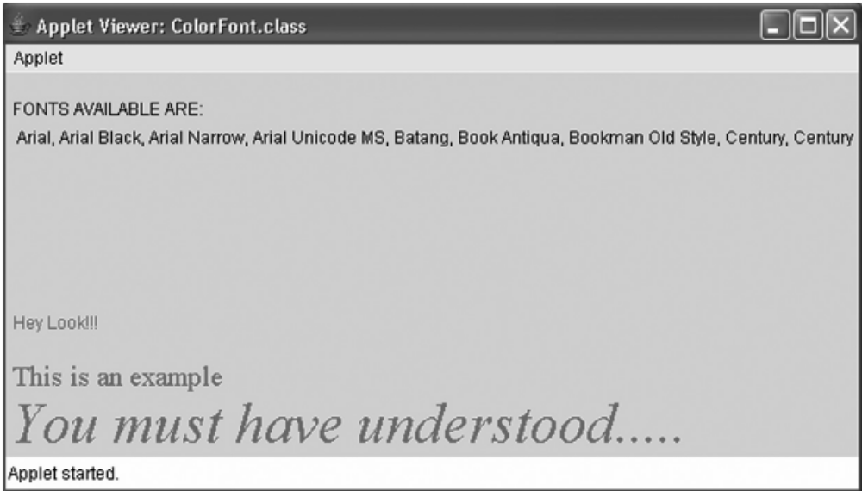
The Output

Slide 48
FontMetrics class
The font metrics objects are defined by FontMetrics class which extends Object class and implements Serializable interface.
You must be aware with the term ‘metrics’. Its literal meaning is ‘measurements’.
The java.awt.FontMetrics class is helpful in determining the measurements associated with characters and strings (group of characters).
The texts can be positioned precisely using these measurements.

Slide 49
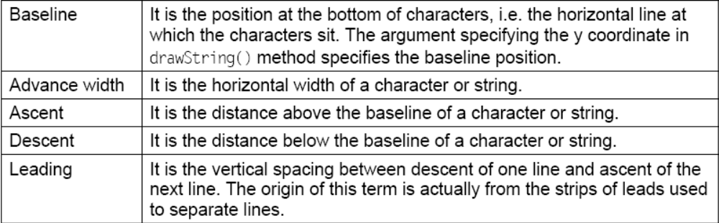
FontMetrics class

Slide 50
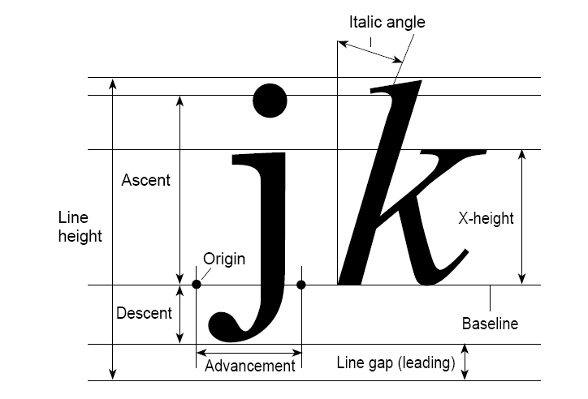
FontMetrics class

Slide 51
Example
/*<applet code=DemoFontMetrics.class width=300 height=300></applet>*/
import java.awt.*;
import java.applet.*;
public class DemoFontMetrics extends Applet {
public void init() {
Color color1 = new Color(255, 255, 250);
setBackground(color1);}
public void paint(Graphics g) {
int fontSize = 20;
g.setFont(new Font(“TimesRoman”, Font.PLAIN,fontSize));
FontMetrics fm = g.getFontMetrics();
String s = “Its my Applet”;
int sw = fm.stringWidth(s);
int w =300;
int h = 300;
int x = (w - sw) / 2;

Slide 52
Example (contd.)
int baseline = fm.getMaxAscent() + (h - (fm.getAscent() + fm.getMaxDescent()))/2;
int ascent = fm.getMaxAscent();
int descent = fm.getMaxDescent();
int fontHeight = fm.getMaxAscent() + fm.getMaxDescent();
g.setColor(Color.pink);
g.fillRect(x, baseline-ascent , sw, fontHeight);
g.setColor(Color.red);
g.drawLine(x, baseline+descent, x+sw, baseline+descent);
g.setColor(Color.blue);
g.drawLine(x, baseline-ascent, x+sw, baseline- ascent);
g.setColor(Color.black);
g.drawString(s, x, baseline);}}

Slide 53
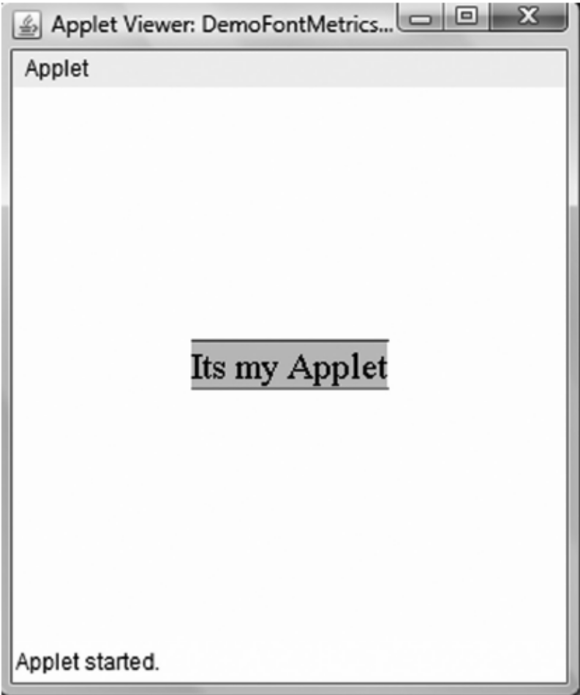
The Output

Slide 54
Digital Clock Example
import java.util.*;
import java.applet.*;
import java.awt.*;
import java.text.*;
/*<applet code=DigitalClock.class width=450 height=100></applet>*/
public class DigitalClock extends Applet implements Runnable{
Thread t;
Calendar c;
Date d;
DateFormat df;

Slide 55
Digital Clock Example
public void init(){
t=new Thread(this,"Time Thread");
t.start();
df=DateFormat.getInstance();}
public void run(){
for(;;){
try{
c=Calendar.getInstance();
d=c.getTime();
Thread.sleep(1000);
}

Slide 56
Digital Clock Example
catch(Exception e){}
repaint();
}}
public void paint(Graphics g){
g.setFont(new Font("Courier New", Font.ITALIC, 20));
g.drawString(d.toString(),30,20);
g.drawString("Different Format " +df.format(d),30,40);
}}

Slide 57
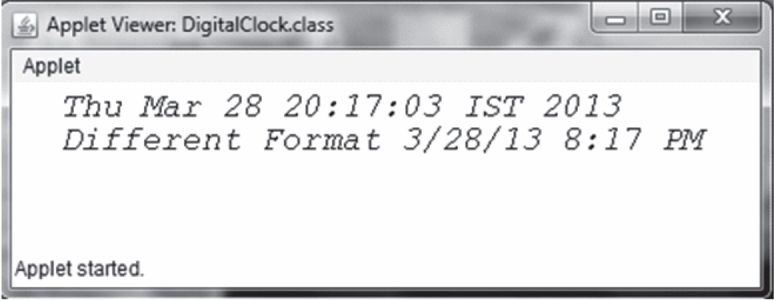
THE Output

Slide 58
Summary
Applets are small programs which can be downloaded from a remote server in its bytecode form and executed on the client, to do a specific job.
In Java, applets can be dealt in two ways.
conventional applet, which use Abstract Window Toolkit (AWT) to get the GUI features.
Other use SWINGS, These applets can be executed on the clients, with the help of either a Java enabled browser or a utility known as appletviewer
Applets have a proper life cycle in which an applet moves from one state to other.
These states of applet life cycle are: Born, Running, Idle, and Dead.
methods such as init(), start(), stop(), and destroy() are respectively called to force an applet to different state.
We have given you an insight of how to handle images and audio files and have a basic understanding of graphics.
We have also seen How to use Threads in Applets.

